Slide 1
CARPOOL RIDE SHARING APP
COEN - 275 Object-Oriented Analysis, Design and Programming
Presented by
Aparnaa Pazhanivelan(07700011640)
Pujitha Kallu(W1653660)
Sowmya Baluvu(07700011659)
Under the guidance of Prof. Paddu Melanahalli (pmelanahalli@scu.edu)

Slide 2
CarPooling Ride Sharing App- Design
A ride-sharing platform that connects drivers and passengers traveling the same routes, helping reduce costs and carbon emissions.
Requirement Analysis:
1. User Profiles: Both drivers and passengers create profiles.
2. Route Matching: The system matches passengers with drivers heading to the same destination at a
similar time.
3. Fare Splitting: Automatically calculate and split fares between passengers, with secure in-app payments.
4. Ride Scheduling: Users can schedule future rides or set up recurring carpooling for daily commutes.

Slide 3
Objective:
Provide a seamless platform for carpooling and ride-sharing, connecting drivers and passengers.
The project is a web-based carpooling/ride-sharing service application.
The application allows users to register, create profiles, and manage their account information.
Users can offer rides by specifying their route, available seats, and departure time.
The system include a ride-matching algorithm to connect drivers with potential passengers.
The application might include features like UserProfile, Route Matching, Fare Splitting, Ride Scheduling
Allow users to search and filter rides based on preferences like timing, route, cost, and driver ratings.
Application includes calculating and split fares between passengers automatically, with a secure in-app payments.

Slide 4
Assumptions
1. Authentication
Authentication is secured using email and password.
2. Ride Creation
Only Drivers can create rides. A user creating a ride will be automatically assigned the DRIVER role.
User should add their vehicle details before creating a ride.
3. Payment
We assume that the card details entered by the user are correct and we abstract out loading money into the wallet.
Payment can be done only after a ride is completed
4. Finding Rides When a user searches for rides using a starting location, destination location, and start time, the matching ride results are selected based on the following criteria:
The ride's starting location is within a 2 miles radius of the starting location in the request.
The ride's destination location is within a 2 miles radius of the destination location in the request.
The ride's start time is within ±15 minutes of the requested start time.
4o

Slide 5
Entities:
User: Represents a user [Driver or Passenger] in the carpool system. Each user has attributes like id, firstName, last Name, email Id, phone Number, password, and dob. Users can create and update their profiles.
Vehicle: Represents a vehicle owned by a user. Attributes include id, owner (a User), number, type, name, color, and seat Count. Users can add new vehicles to the list.
Ride: Represents a ride in the carpool system. Attributes include id, vehicle (a Vehicle), location (pick-up location), trip status , type [one-day,recurring], destination Location, startTime, available Seats, and createDate. Users can create, find, join and cancel rides.
Ride Participant: Represents a participant in a ride. Attributes include id, ride (a Ride), participant (a User), role, status, joined At, and cancelled. Users can join and cancel rides.

Slide 6
Entities contd..
Location: Represents a location with attributes like id, latitude, longitude, and address. Users can set locations on map
Fare: Represents the fare for a ride. Attributes include id, ride (a Ride), amount, and status. Depending up on the distance travelled Fare is automatically generated and viewed on the screen.
Wallet: Represents a user's[Passenger or Driver] wallet. Attributes include id, userId, balance, card Number, cardHolder Name, expiry Date, and billing Address. Wallets are used for handling payments.
Transaction: Represents a transaction between drivers and passengers in the carpool system. Attributes include id, amount, user (a User), fare (a Fare), type, status, description, and completed At. Users can create transactions.
RecurringToOneTimeRideLink: Represents a link between a recurring ride and a one-time ride. Attributes include id, recurring Ride (a Ride), and oneTimeRide (a Ride).

Slide 7
Key Technology and Components:
Technology Stack:
Backend - Java/Spring Boot
Database - MySQL
Frontend - HTML/CSS/JavaScript
DTO - Data Transfer Objects (DTOs) are used to transfer structured data between different layers of an application, minimizing the amount of information shared.
Database Integration - Integration of the application with a database to store, retrieve, and manage data.
Map Integration - Integrating Google Maps API in our carpooling app to display routes.Used for pick-up/drop-off points.
Global Exception Handling - A mechanism to handle exceptions across the application uniformly.
Maven -A build automation and dependency management tool for Java projects.
HTTP status codes - Codes that indicate the result of an HTTP request, categorized into classes like 2xx (success), 4xx (client errors), and 5xx (server errors).

Slide 8
Object oriented concepts used in the application
1. Classes and Interfaces:
● Classes: Represent entities such as User, Vehicle, Ride, Ride Participant, Location, and Fare. These classes
encapsulate attributes and behaviors, serving as blueprints for creating objects in the system.
● Interfaces: Used to define contracts for service layers like UserService, RideService, and Vehicle Service,
ensuring consistent implementation across the application.
Usage: Classes like UserController, RideController, Vehicle Controller, and RideService encapsulate functionality and attributes related to user management, ride management, and vehicle operations.
2. Attributes and Methods:
● Attributes: Represent the state of the class (e.g., name, email, vehicle Number, seat Count, etc.).
● Methods: Define the behavior of classes (e.g., createRide, join Ride, update UserProfile).
Usage:
● Users have attributes like name, email, and phone Number, and methods like createUser and updateProfile.
● Ride includes attributes such as startTime, endTime, and available Seats, and methods like createRide and cancel Ride

Slide 9
Object oriented concepts used in the application contd..
3. Inheritance:
Driver and Passenger classes inherit from User.
RecurringRide class and OneTimeRide class inherit from Ride.
Abstract classes or interfaces like BaseService may define common functionality that is inherited by RideService, UserService, etc.
4. Association:
User has a one-to-many association with Vehicle (a user can own multiple vehicles).
User has a one-to-one association with Wallet.
Ride has a many-to-one association with Vehicle
Ride has a one-to-one association with Fare.
Ride is associated with Location (pickup and destination) and Ride Participant (drivers and passengers).
Ride has a one-to-many association with Transaction.
5. Composition:
Ride has many Transactions(deleting a ride deletes all Transactions).
User has many Vehicles.

Slide 10
Object oriented concepts used in the application contd..
6. Aggregation:
Ride has many users. (Deleting the ride doesn’t delete the users)
Ride has locations.
7. Polymorphism:
The Ride class has methods like create, join, and cancel, which perform slightly different operations depending on whether the ride is a RecurringRide or a OneTimeRide. For example, calling ride.cancel() executes the appropriate operations based on the type of Ride.
When a User cancels a ride by calling user.cancelRide(), the appropriate method is invoked, performing operations specific to the user's role (driver or passenger).

Slide 11
System Architecture
System architecture refers to the conceptual model that defines the structure and behavior of a system. It includes layers such as the Presentation Layer (Frontend), Application Layer (Backend), Data Layer, Database, Security Layer, External Services, and Configuration and Deployment. Key design principles include separation of concerns, scalability, maintainability, and security. In carpooling application, the architecture ensures efficient ride management, user authentication, payment processing, and interaction with external services like geolocation and payment gateways.

Slide 12
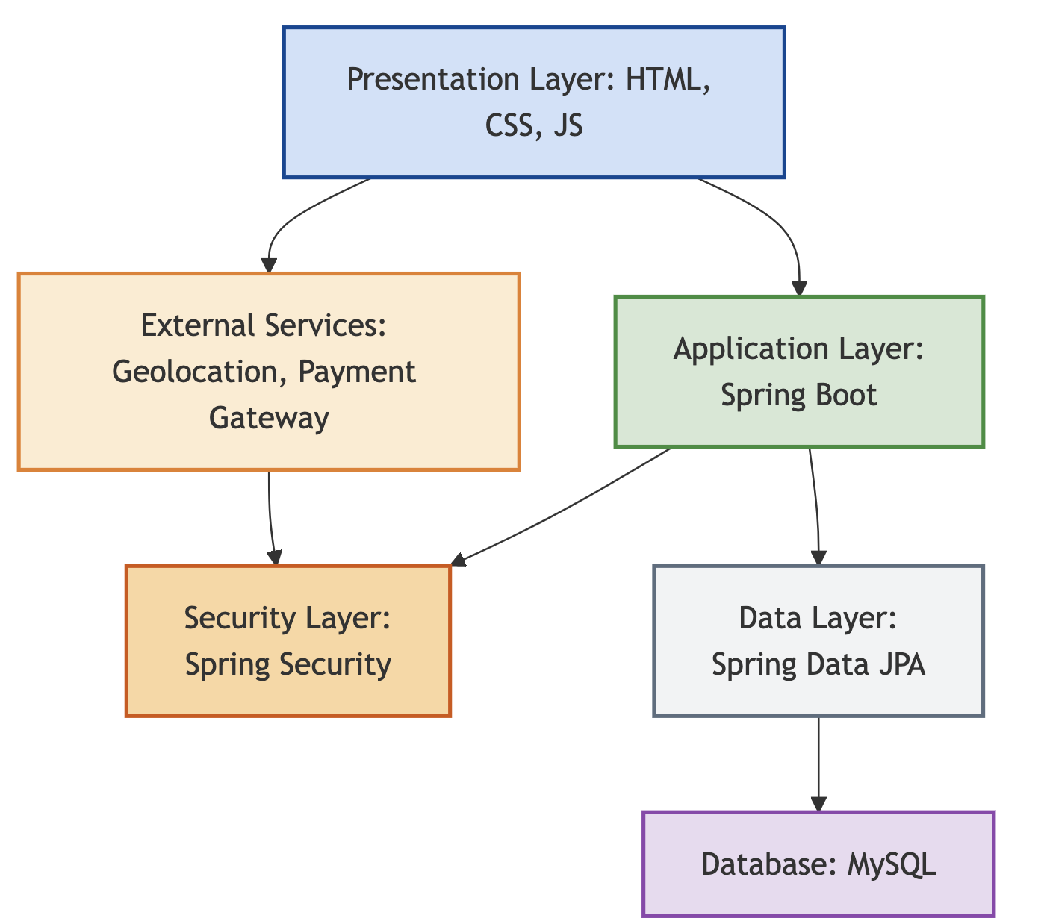
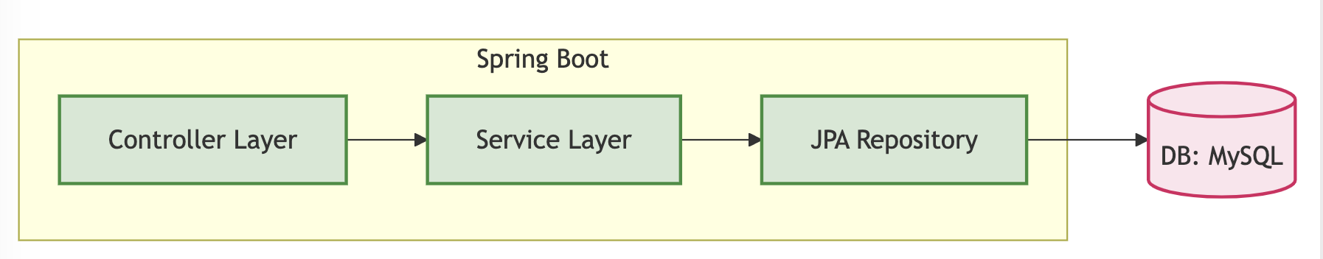
System Architecture contd..

Slide 13
System Architecture contd..
Distributed MVC:
Model: Represents the core data structure and database entities, including User, Ride, and others.
View: Manages the frontend of the application using HTML/CSS/JS, allowing users to interact with the system.
Controller: Responsible for handling HTTP requests and providing responses using Spring Boot RESTful API capabilities
Model:
Core entities (USER, RIDE, etc.) manage data and business logic.
JPA Repository (Supports the Model layer):
Simplifies database access with CRUD operations (UserRepository, Ride Repository).
DTO (Helps transfer data securely between layers):
Transfers required data securely between layers (UserDto, Ride Dto).
Controller (Handles interactions with the application):
Handles HTTP requests, interacts with services, and returns JSON (e.g., UserController, RideController).
Service Layer (Encapsulates core business logic):
Encapsulates business logic (UserService, RideService) for modularity and testability.
Model: Core entities (USER/RIDE etc.) manage data and business logic.
Controller: Handles HTTP requests, interacts with services, and returns JSON (e.g., UserController, RideController).
Service Layer: Encapsulates business logic (UserService, RideService) for modularity and testability.
JPA Repository: Simplifies database access with CRUD operations (UserRepository, RideRepository).
DTO: Transfers required data securely between layers (UserDto, RideDto).
Communication: RESTful APIs exchange JSON between frontend and backend.
Distributed MVC:
Model: Entity classes and repositories.
Controller: Spring Boot REST endpoints.
View: Frontend (HTML/CSS/JS).

Slide 14
Use cases
Create Account: Users can create an account to use the application.
Login/Logout: Users can log in and log out of the application.
Setup Wallet: Users can set up a wallet to send and receive payments.
Load Wallet: Users can add money to their wallet at any time.
Add Vehicle: Users can add their vehicle details for later use when creating a ride.
Create Ride: Users can pick a vehicle and create a one-time or recurring ride, specifying details such as start and end locations, the date for one-time rides, days of the week for recurring rides, and start time.
Find Ride: Users can search for available rides (one-time or recurring) based on start location, destination location, and arrival time.
Join Ride: Users can join an existing ride as a passenger.
Cancel Ride: Users can cancel a ride they created or leave a ride they joined before the start time.
View Owes/Owed: Users can view a summary of how much they owe and how much they are owed in the payments summary.
Make Payment: Users can make payments for completed rides.

Slide 15
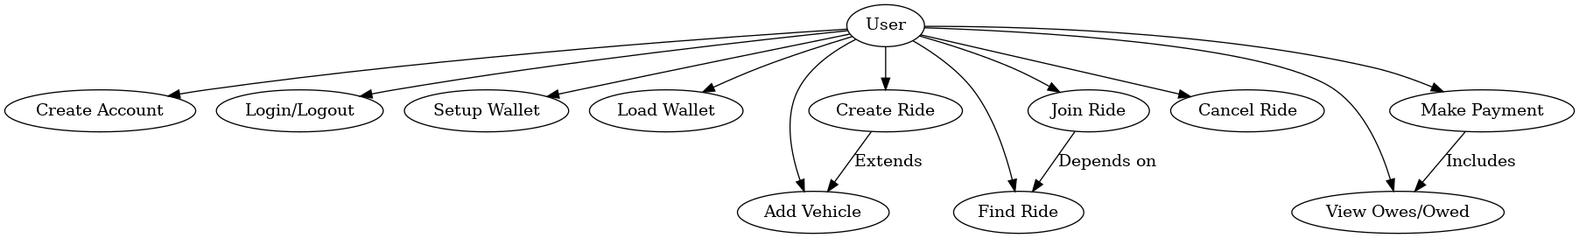
Use Case Diagram

Slide 16
Payments and Transaction Management
1. One-Time Rides:
A transaction is generated for a passenger as soon as they join a one-time ride.
Once the ride is completed, the passenger can make the payment, and the transaction is marked as completed.
2. Recurring Rides:
A cron job runs every night at 12 a.m. to check for recurring rides scheduled for the current day.
For each recurring ride on that day, a corresponding one-time ride is created along with the participants and their transactions.
This ensures participants only deal with payments for completed rides.
3. Edge Case:
If a recurring ride’s start time is ahead and includes the current day in its schedule, it also handles creating the one-time ride and its associated data at the time of the initial request.

Slide 17
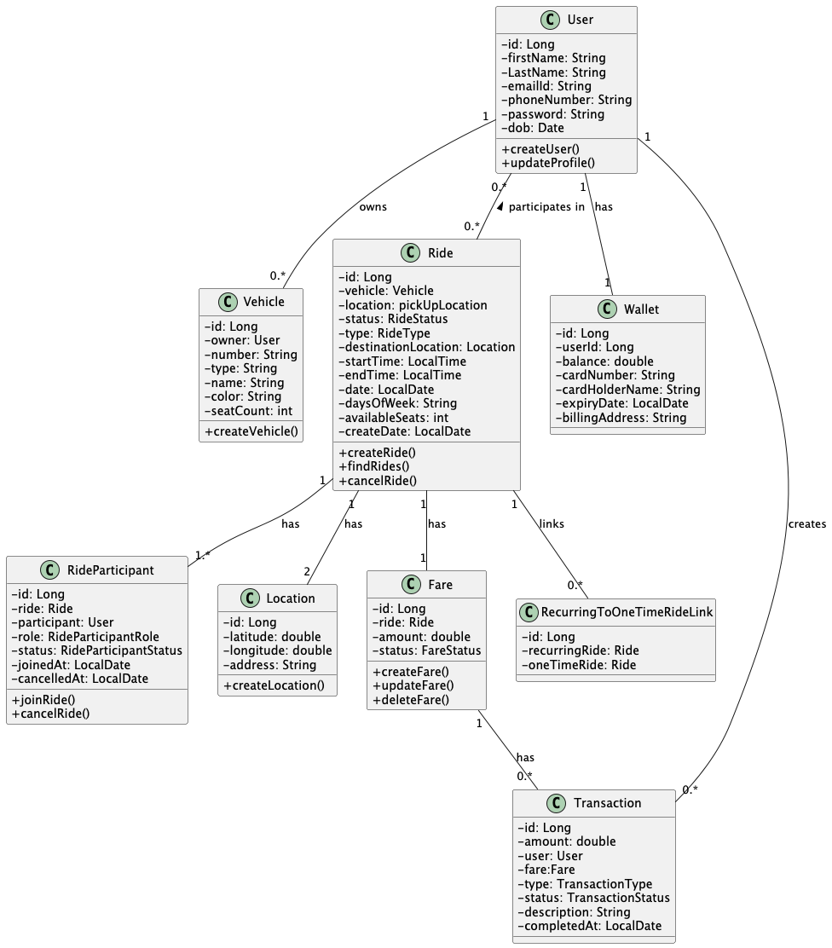
Class Diagram:
The diagram represents a carpooling system where a user can own multiple vehicles and participate in multiple rides. Each vehicle belongs to a specific user and includes details such as number, type, and seat count. Rides are created by users, linked to a vehicle, and associated with specific locations for pickup and drop-off. Rides also include details like start time, end time, available seats, and ride status. Ride participants are users who join rides, either as drivers or passengers, with roles and statuses tracked for each participant. Locations are fined by latitude, longitude, and address, representing the start and destination points of a ride. Fares are tied to specific rides, including the amount and status, such as pending or completed. The relationships between these entities define how users interact with vehicles, rides, locations, and payments in the carpooling system.

Slide 18
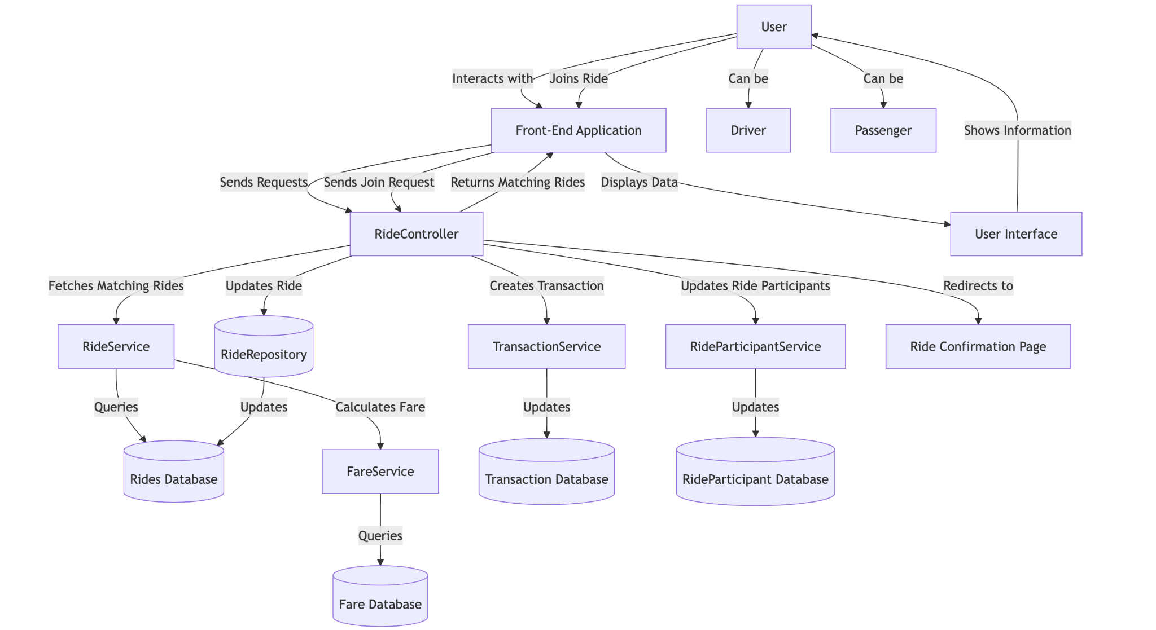
Activity Diagram:
This activity diagram outlines the main activities in the Carpooling Ride Sharing Application, including user authentication, creating rides, validating ride details, saving rides, joining rides, canceling rides, and making payments

Slide 19
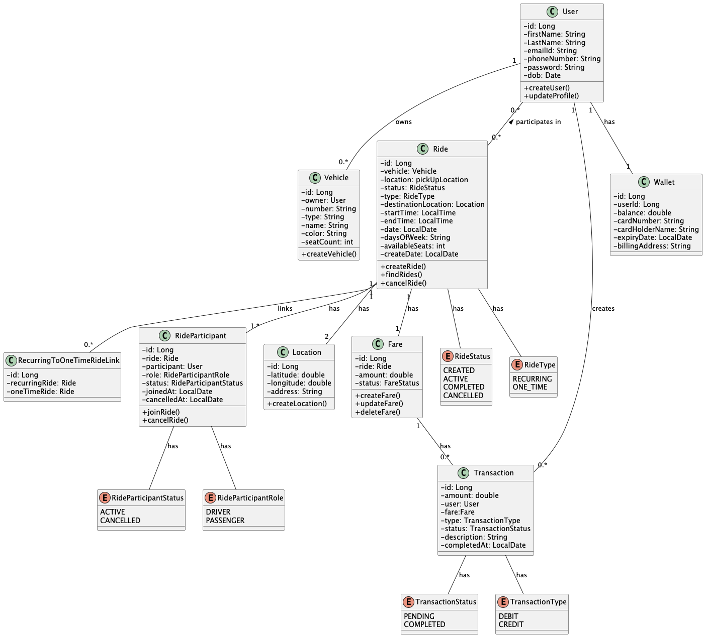
UML Diagram
Carpooling RideSharing:
This UML diagram represents a carpooling system, detailing key entities like User, Vehicle, Ride, Location, Ride Participant, and Fare. It illustrates how users can own vehicles, create or join rides, and manage their roles as drivers or passengers. The system supports ride management with pickup and destination locations, fare calculation, and role-based participation. Enumerations like RideStatus define the state of rides and payments, ensuring a structured and efficient process for booking and sharing rides.

Slide 20
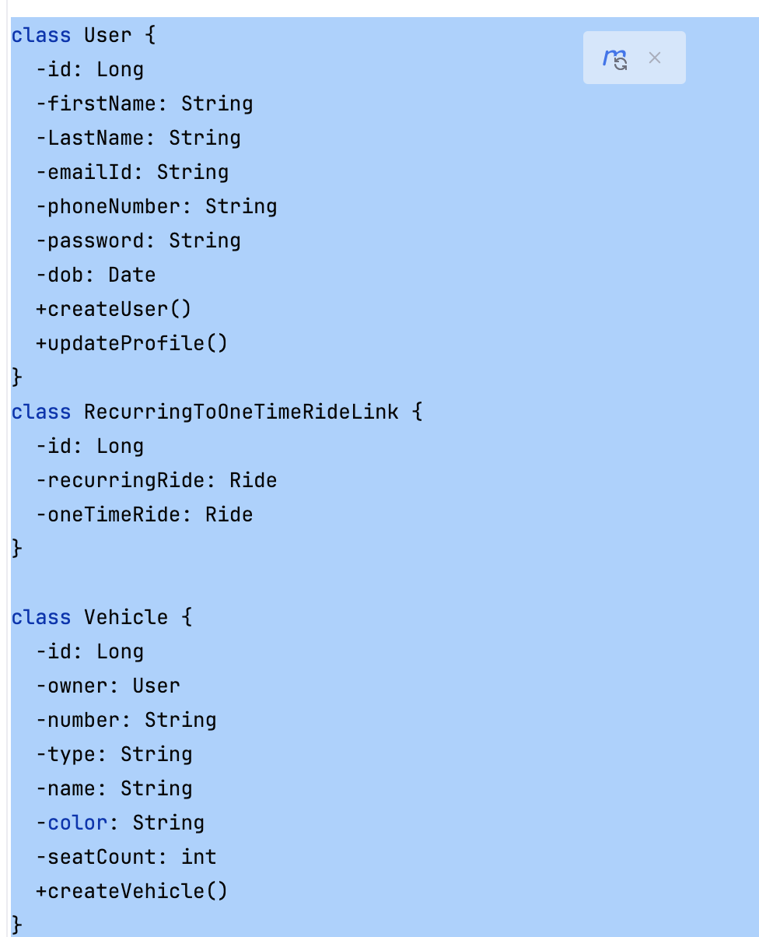
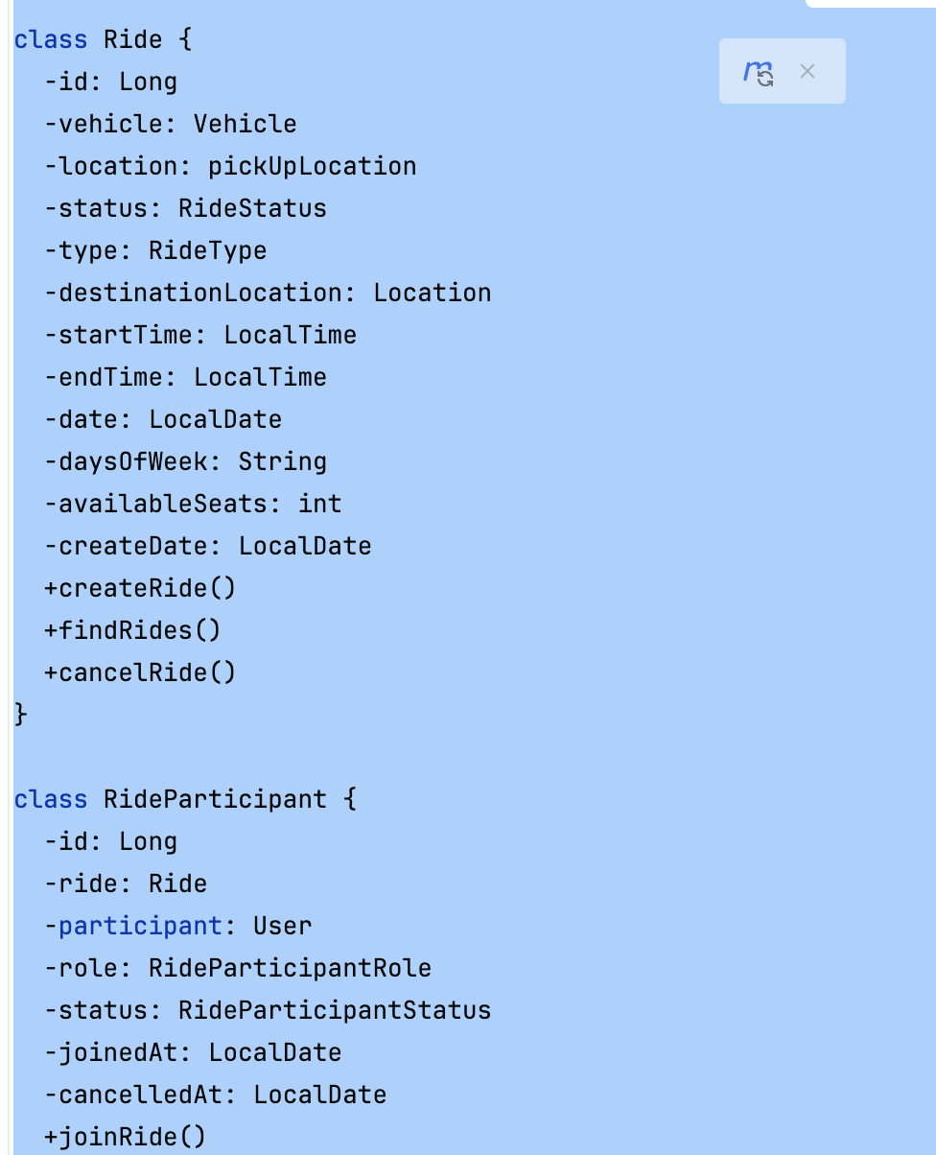
Class [ Code]

Slide 21
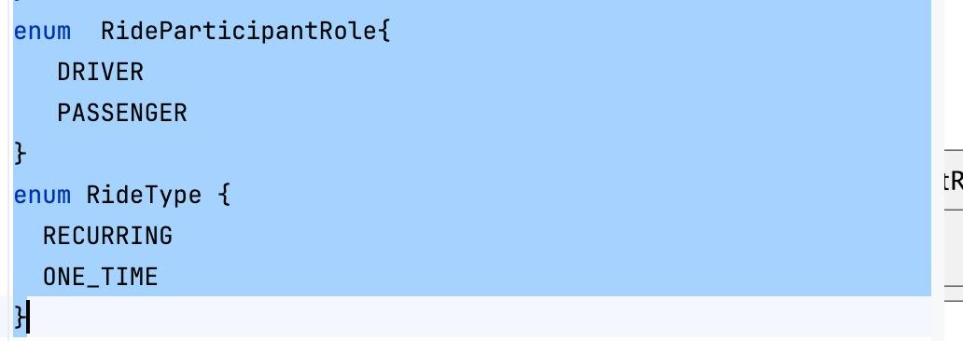
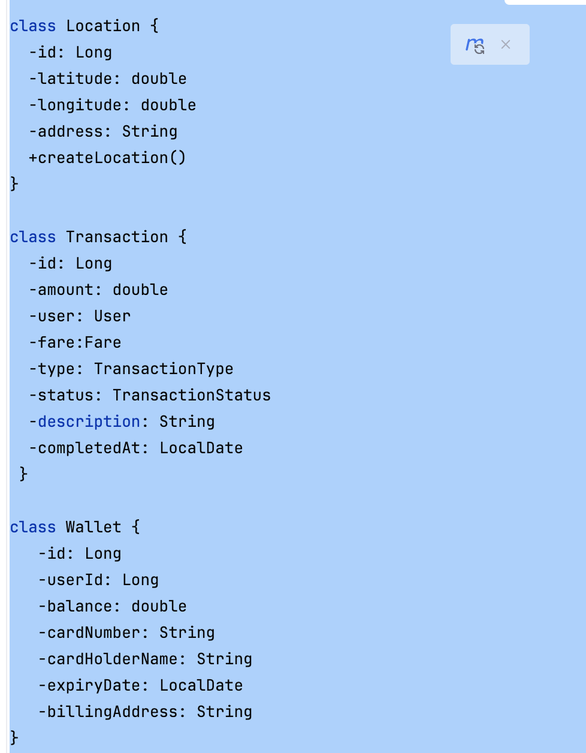
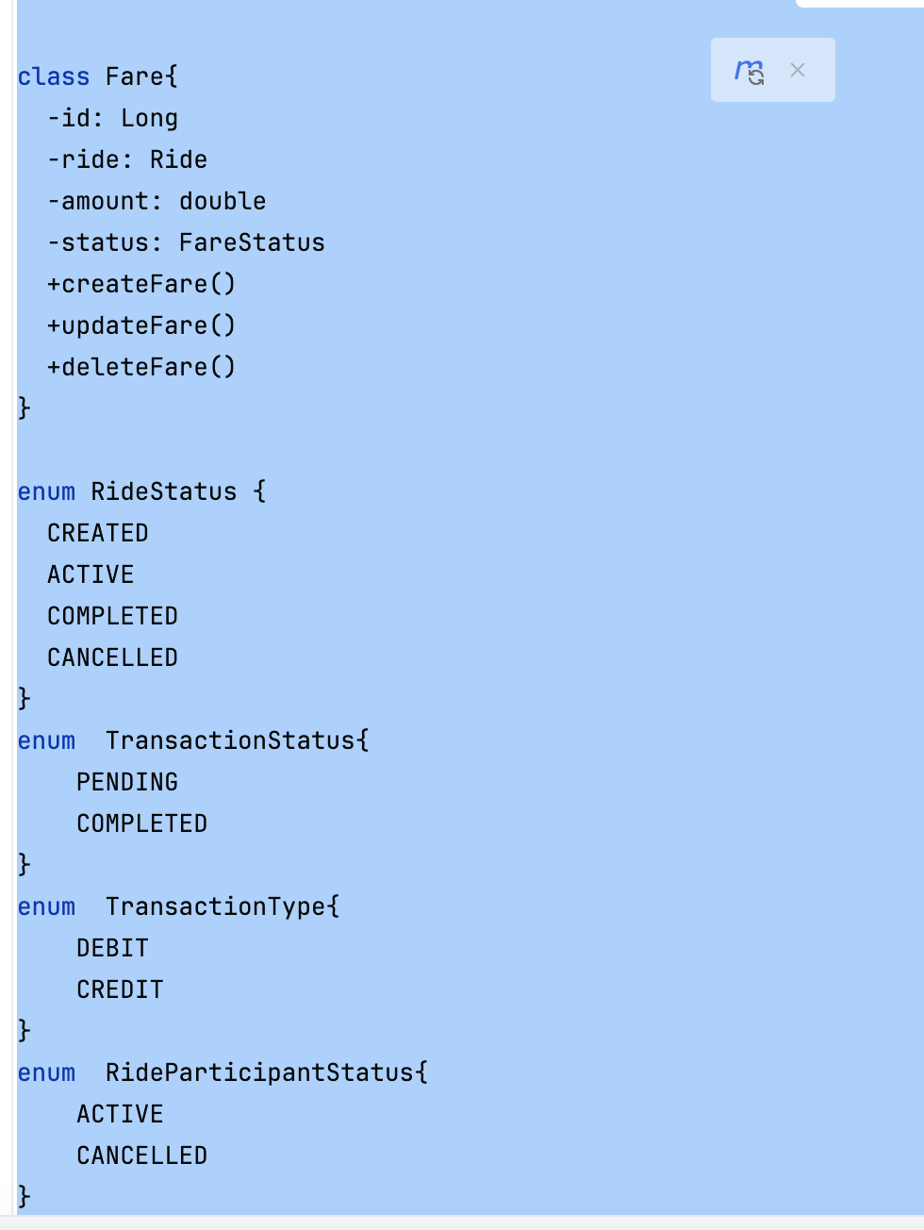
cont]

Slide 22
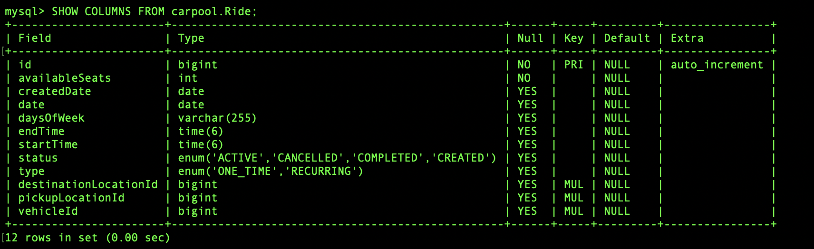
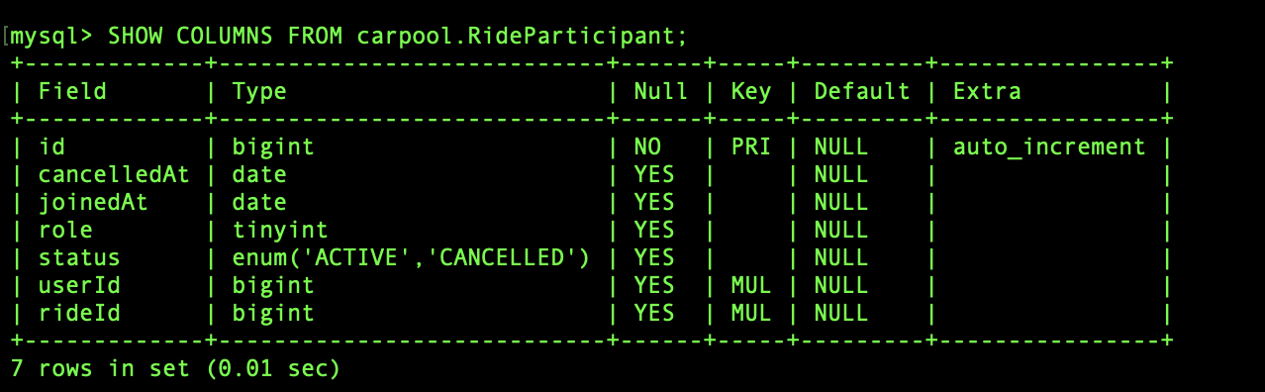
Tables:

Slide 23
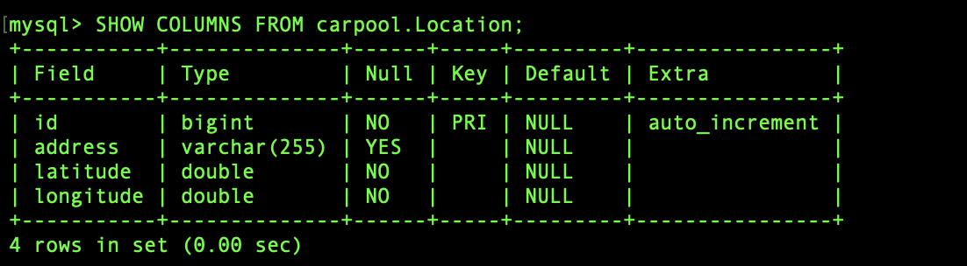
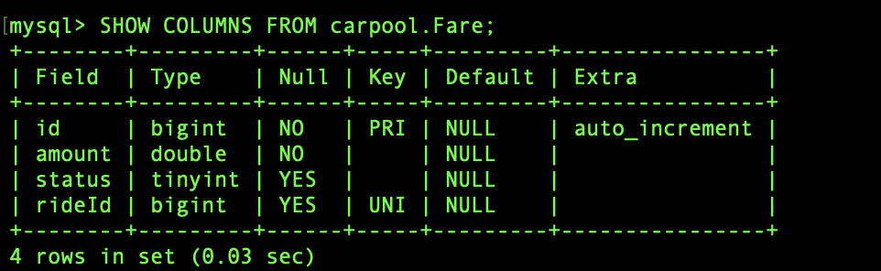

Slide 24
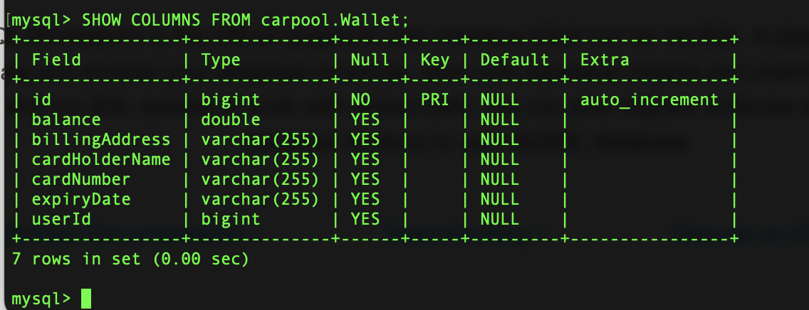
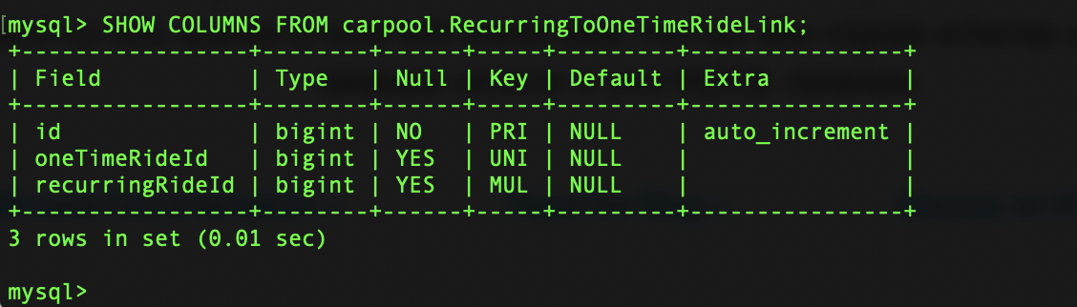

Slide 25
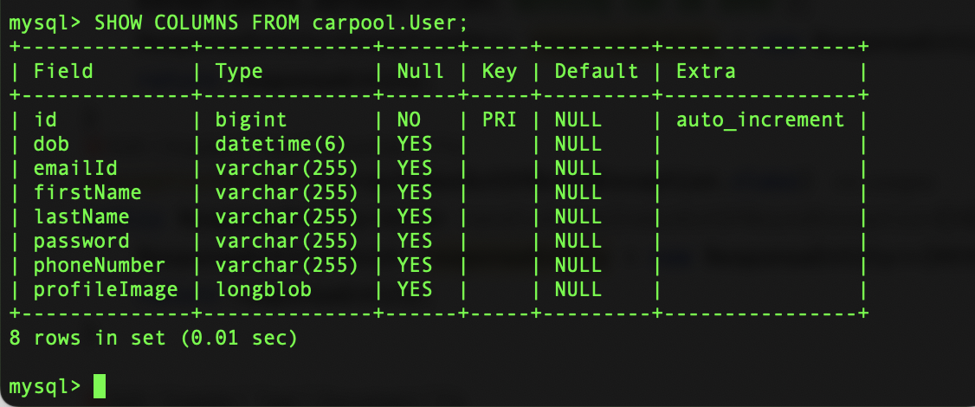
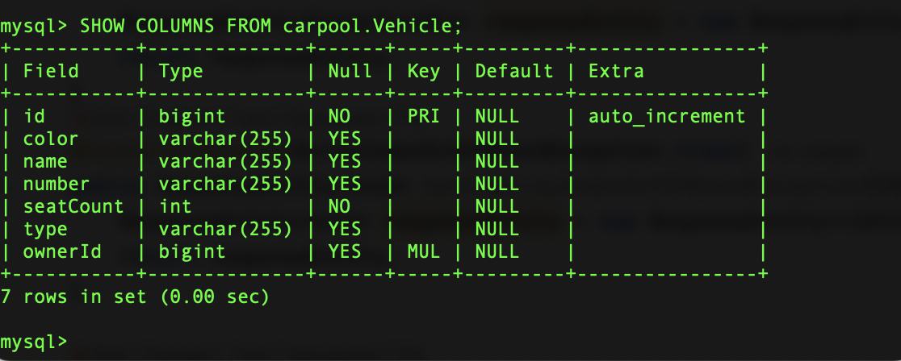

Slide 26
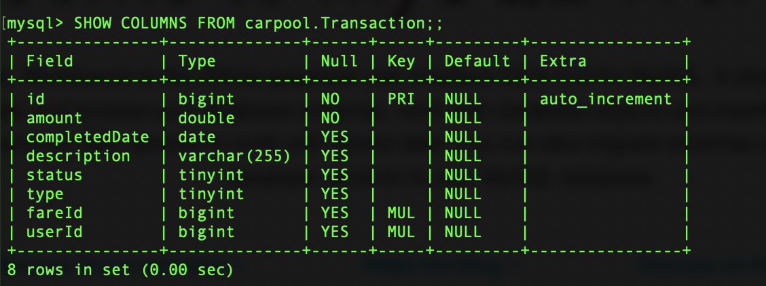

Slide 27
Output Screenshots

Slide 28
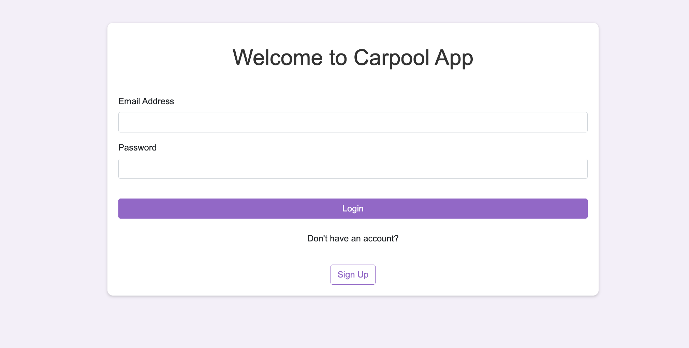
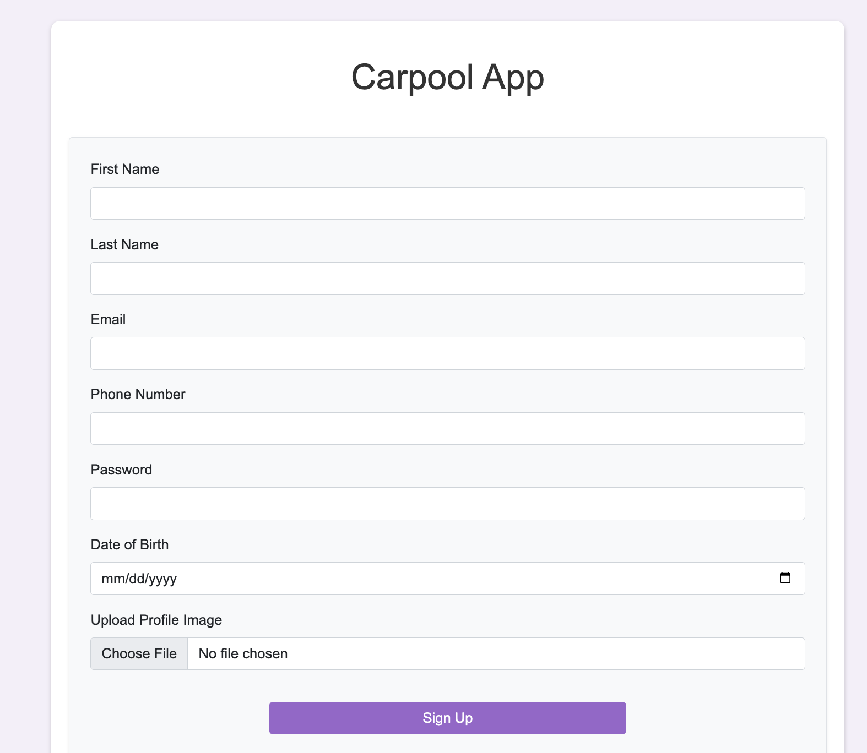
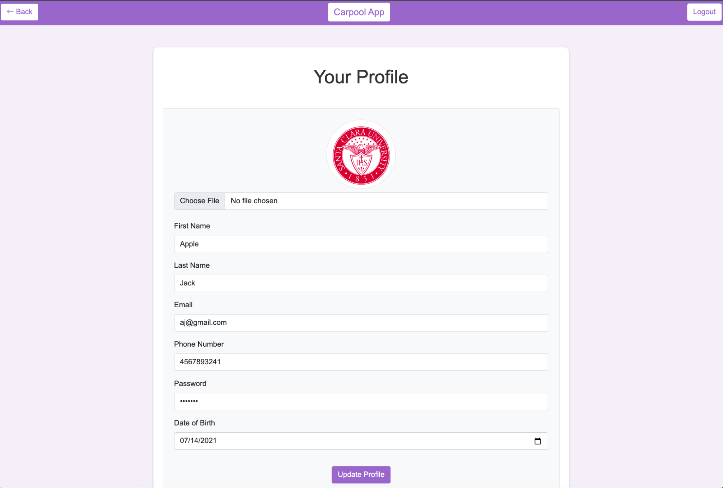
Authentication
Login:
Signup
Edit Profile

Slide 29
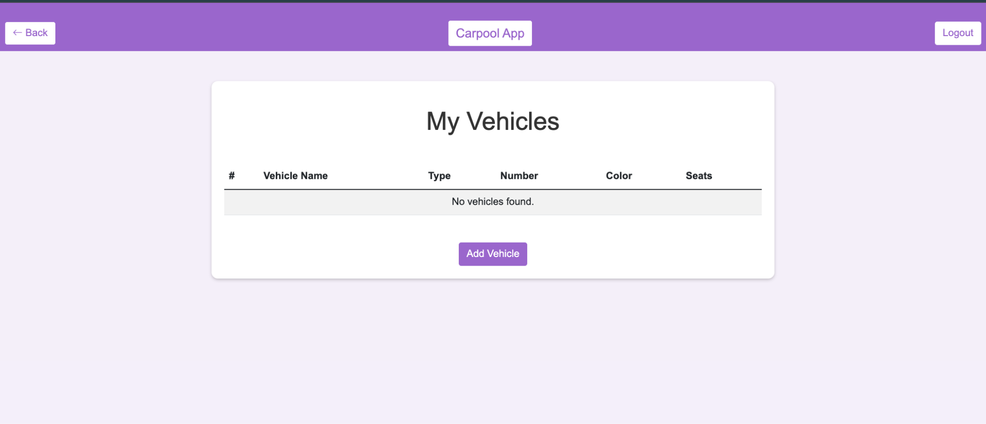
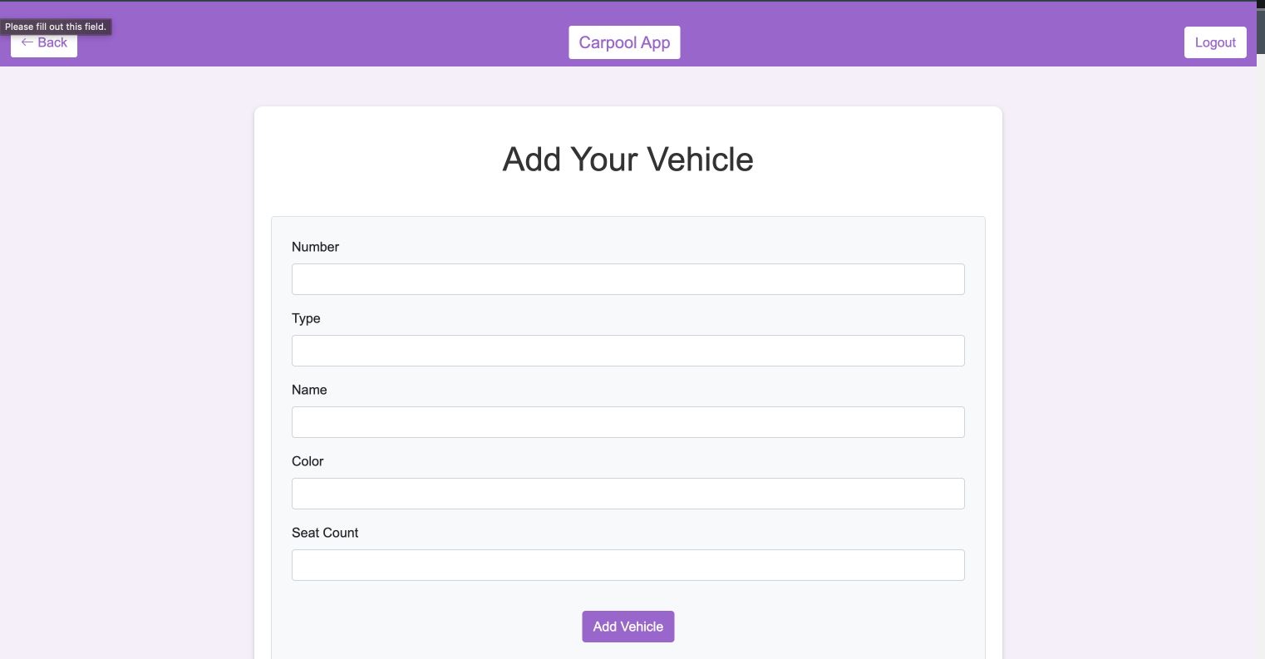
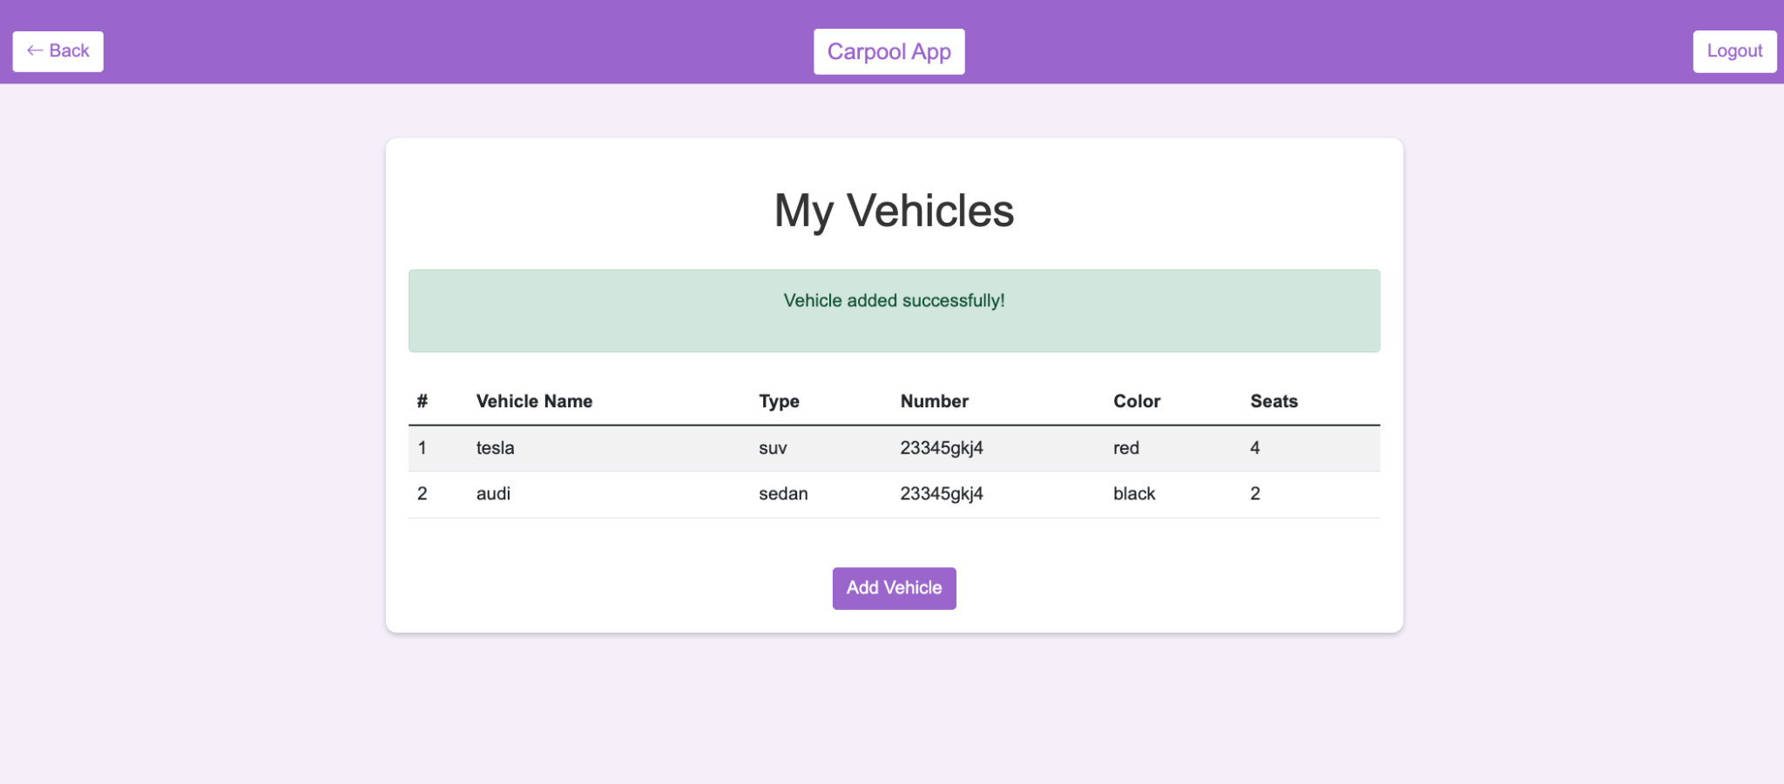
Vehicles
Vehicle Details
New Vehicle Form

Slide 30
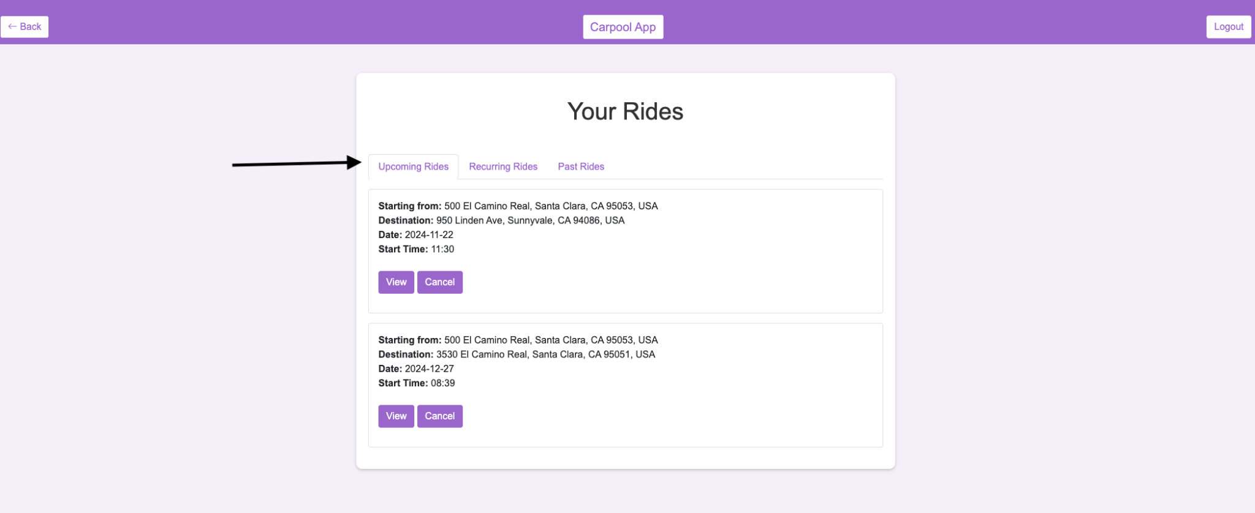
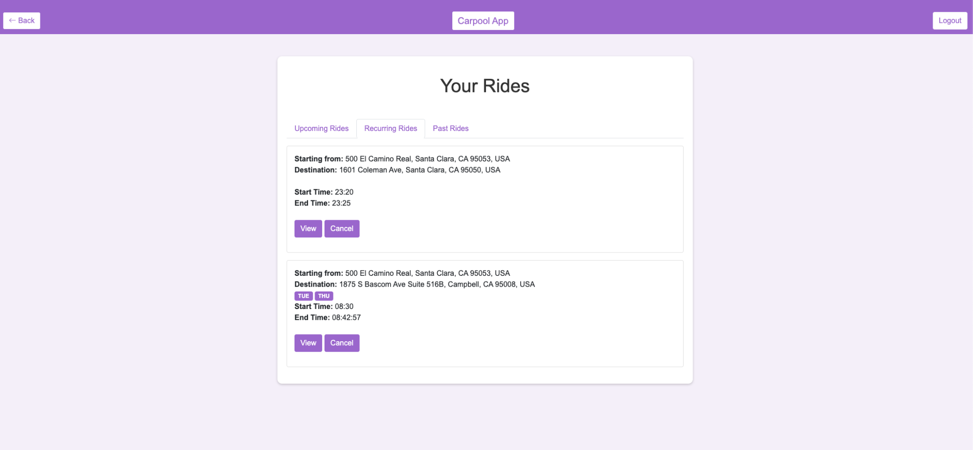
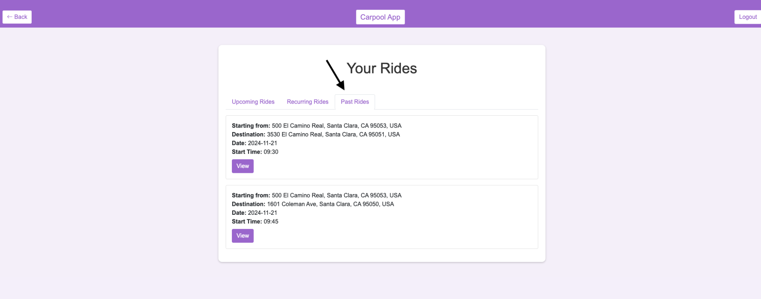
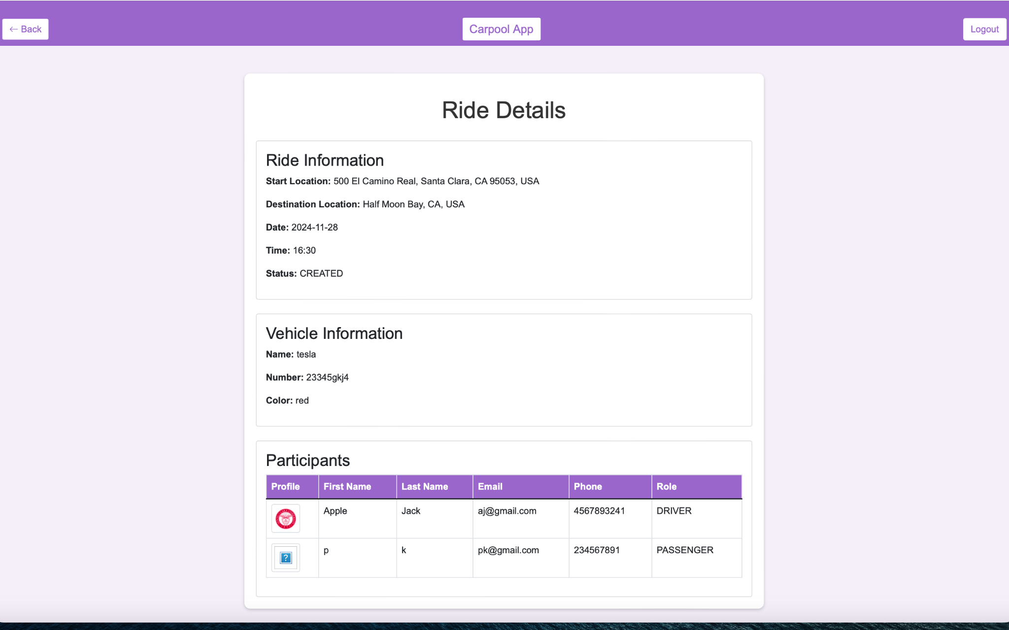
View Rides

Slide 31
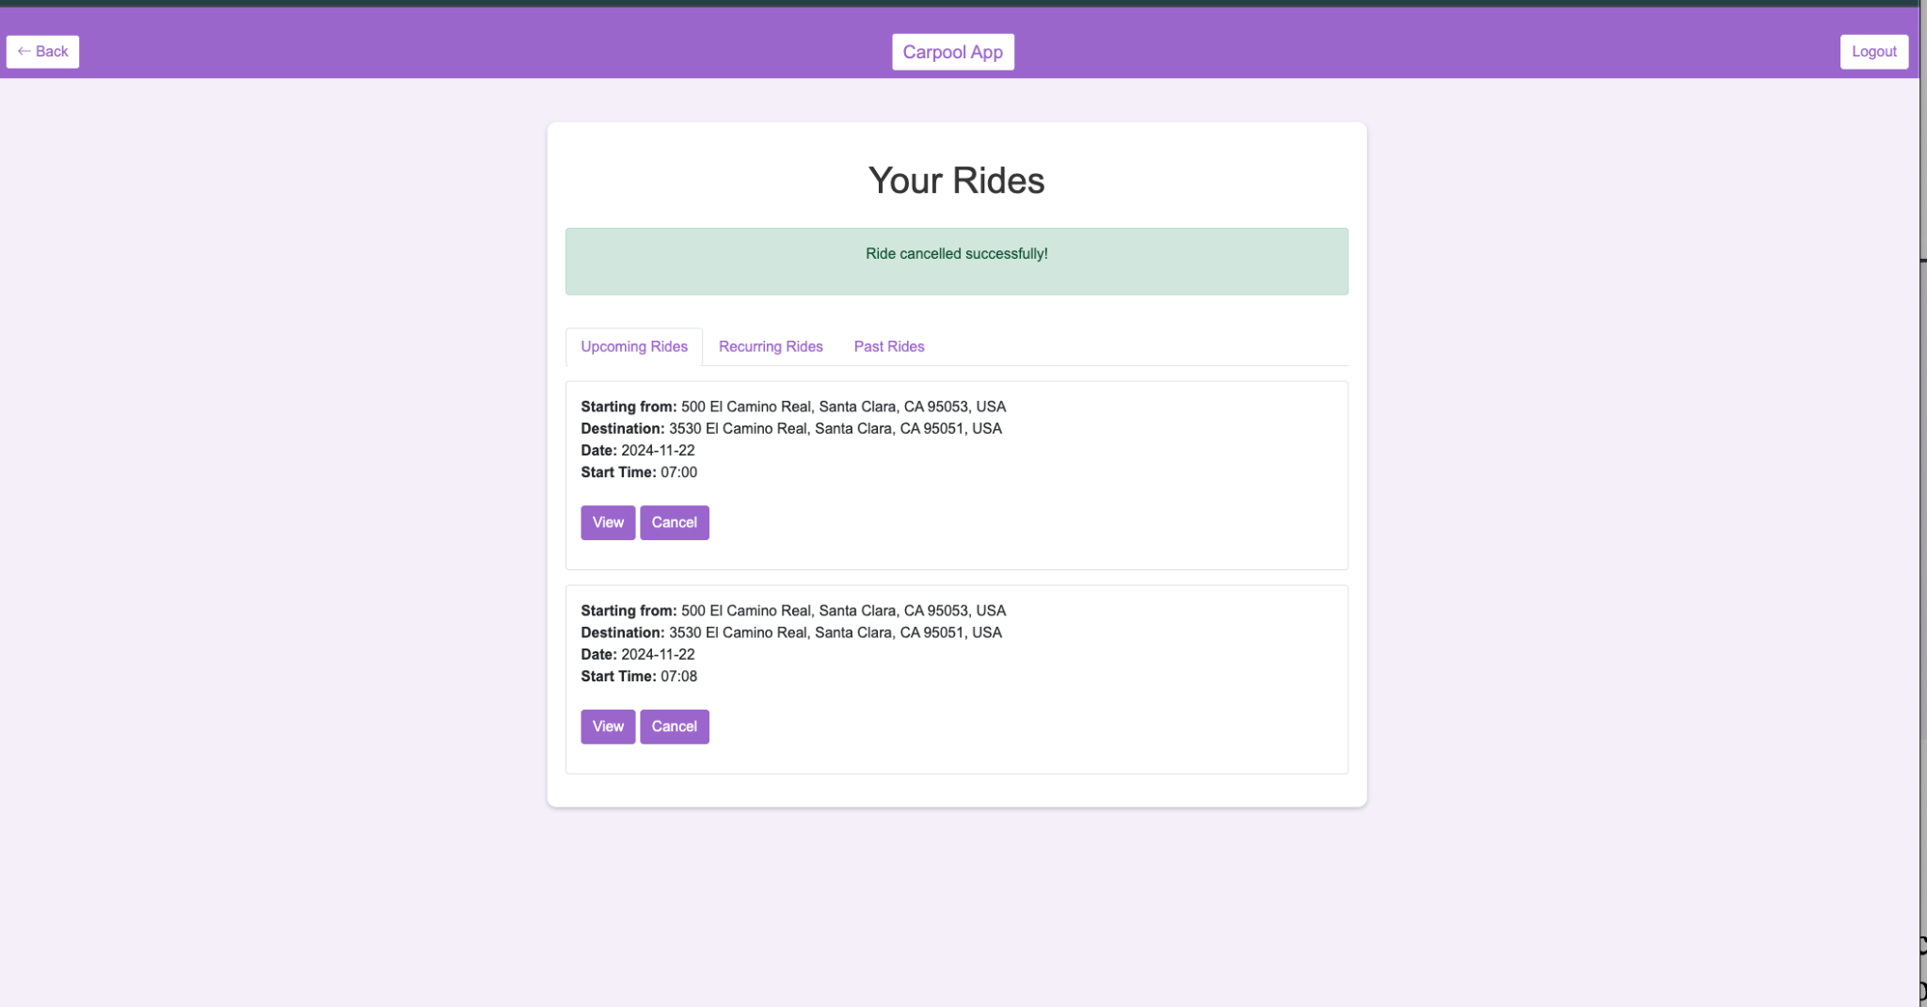
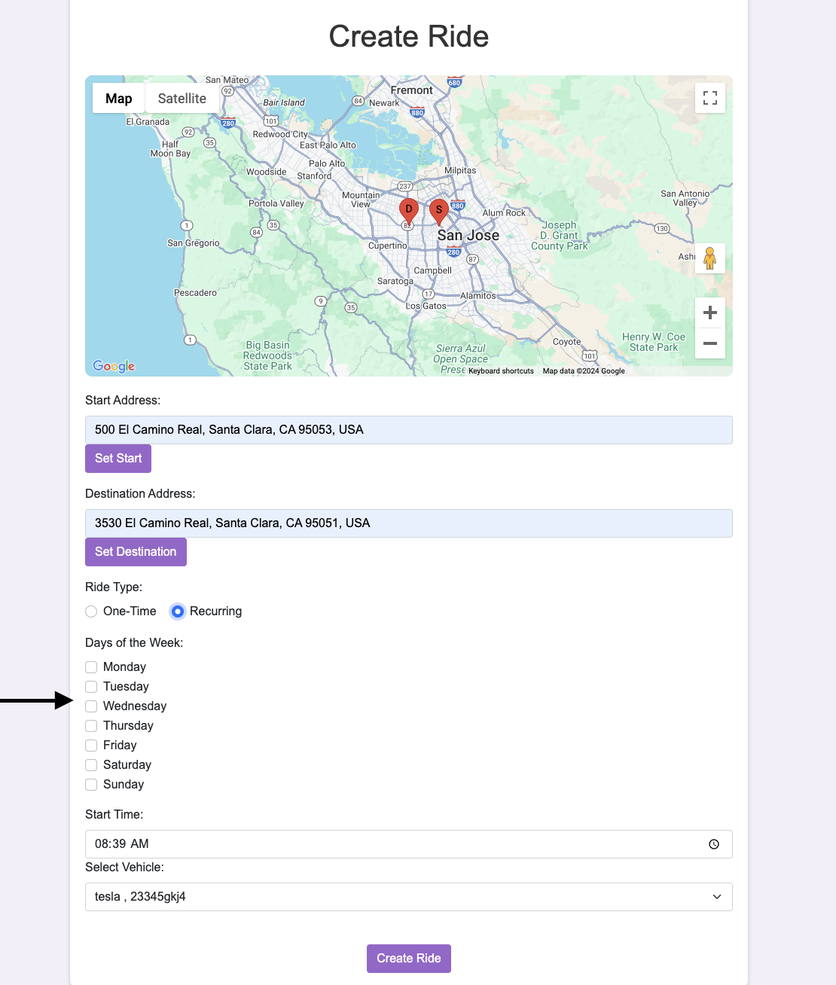
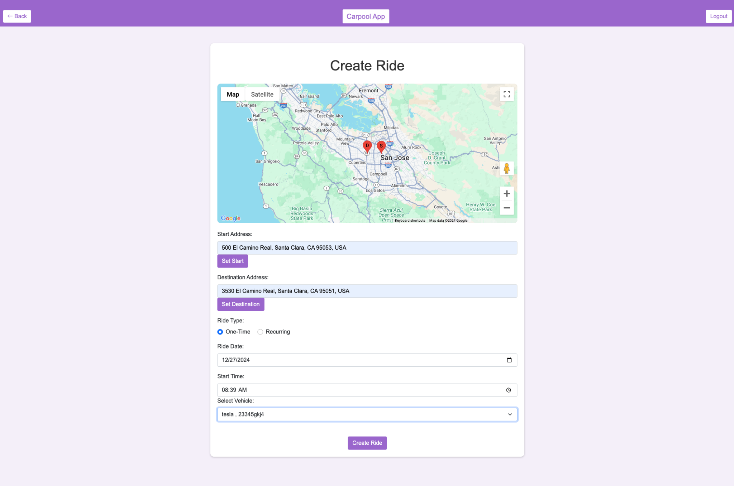
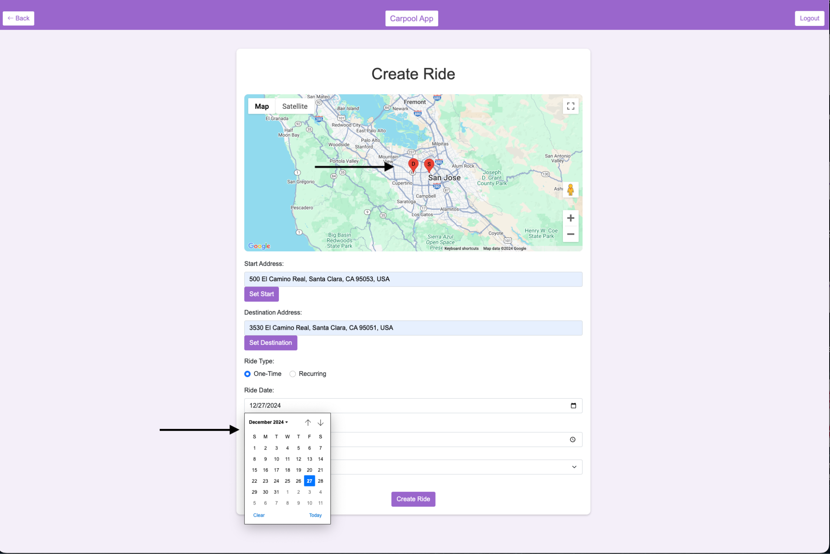
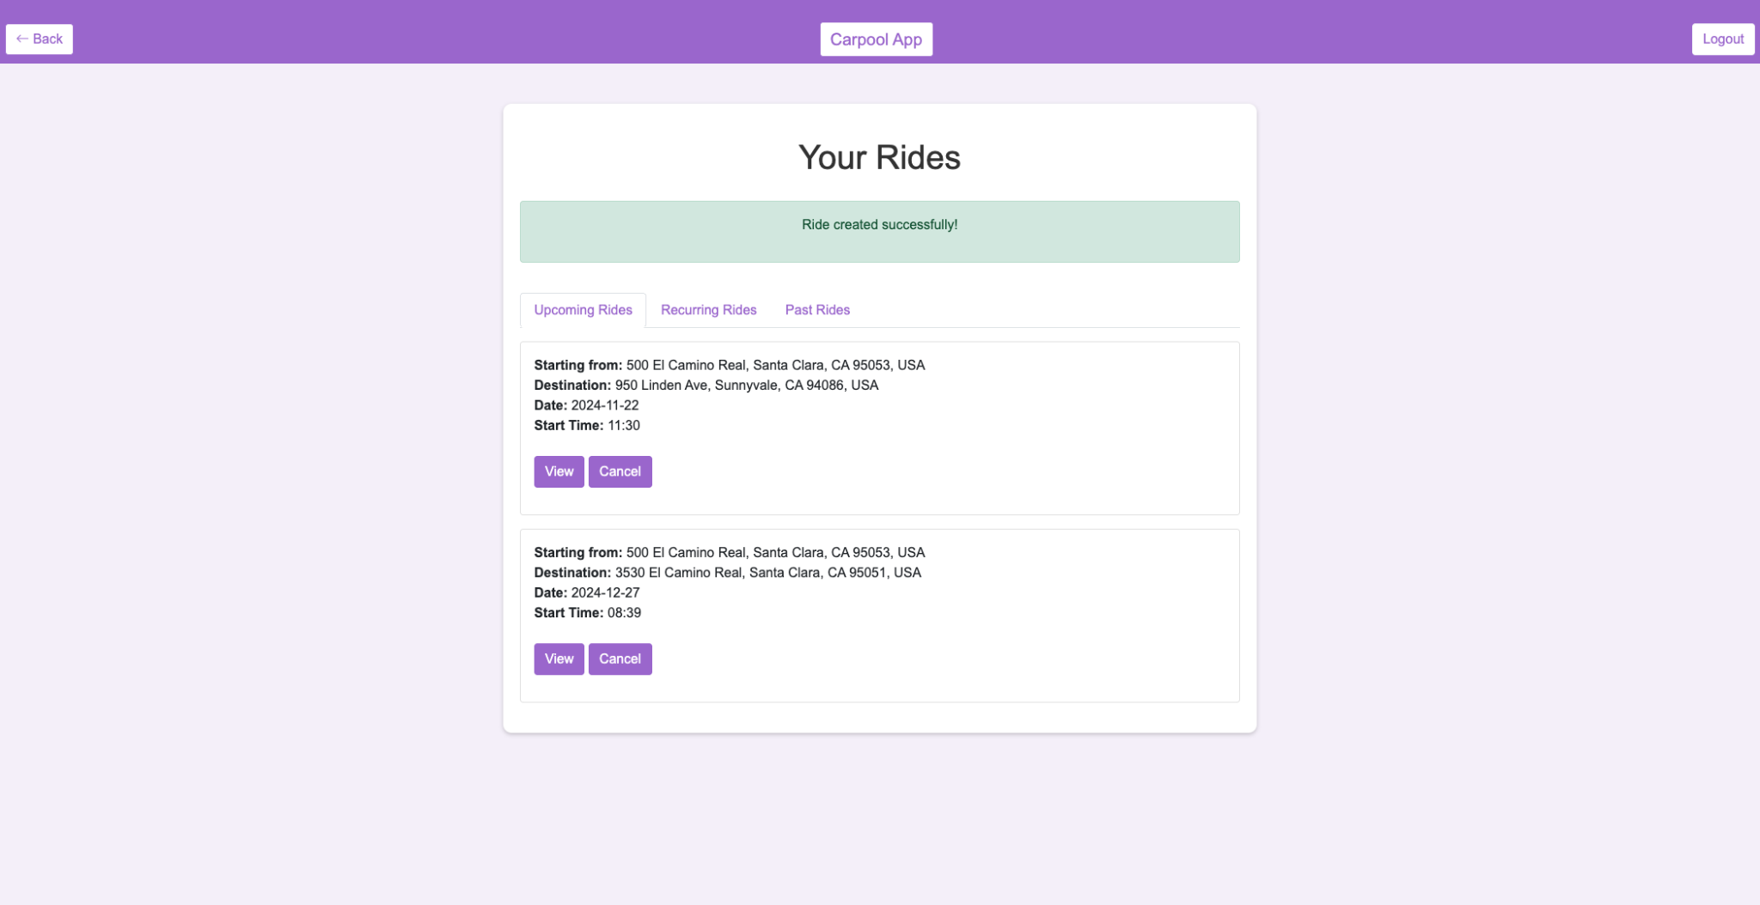
Create Ride

Slide 32
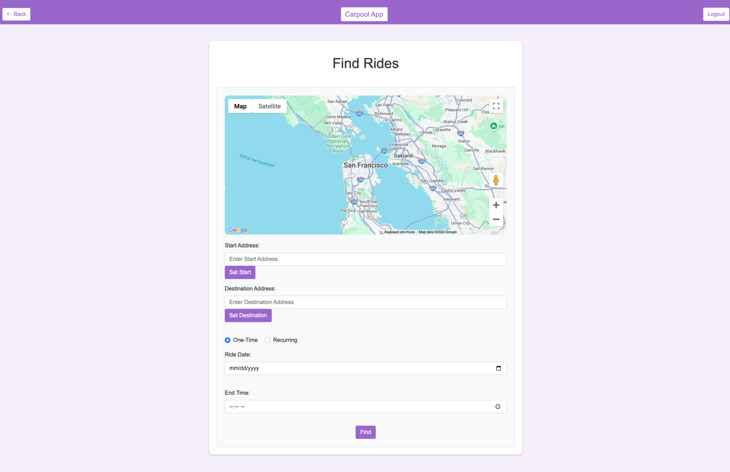
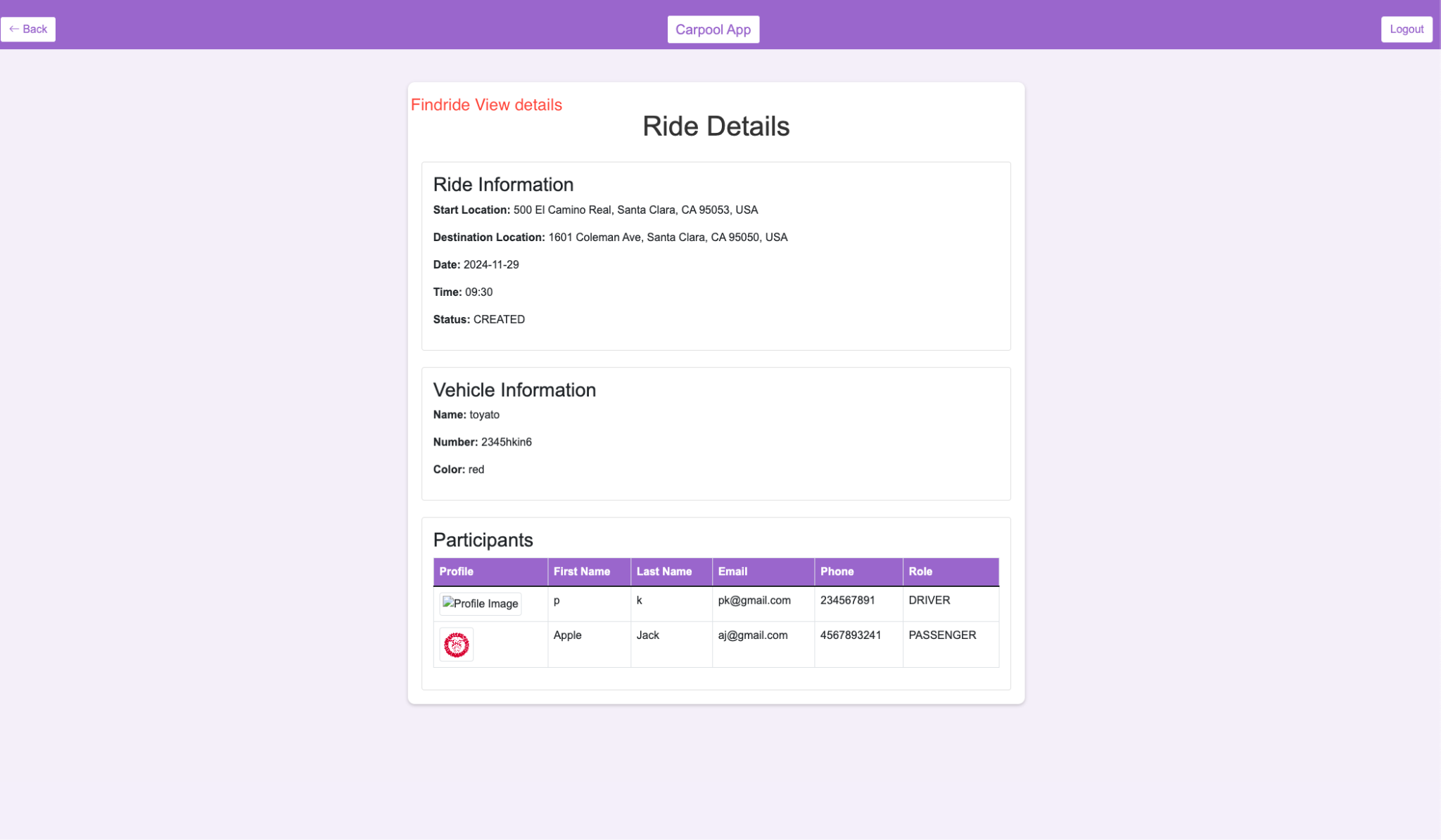
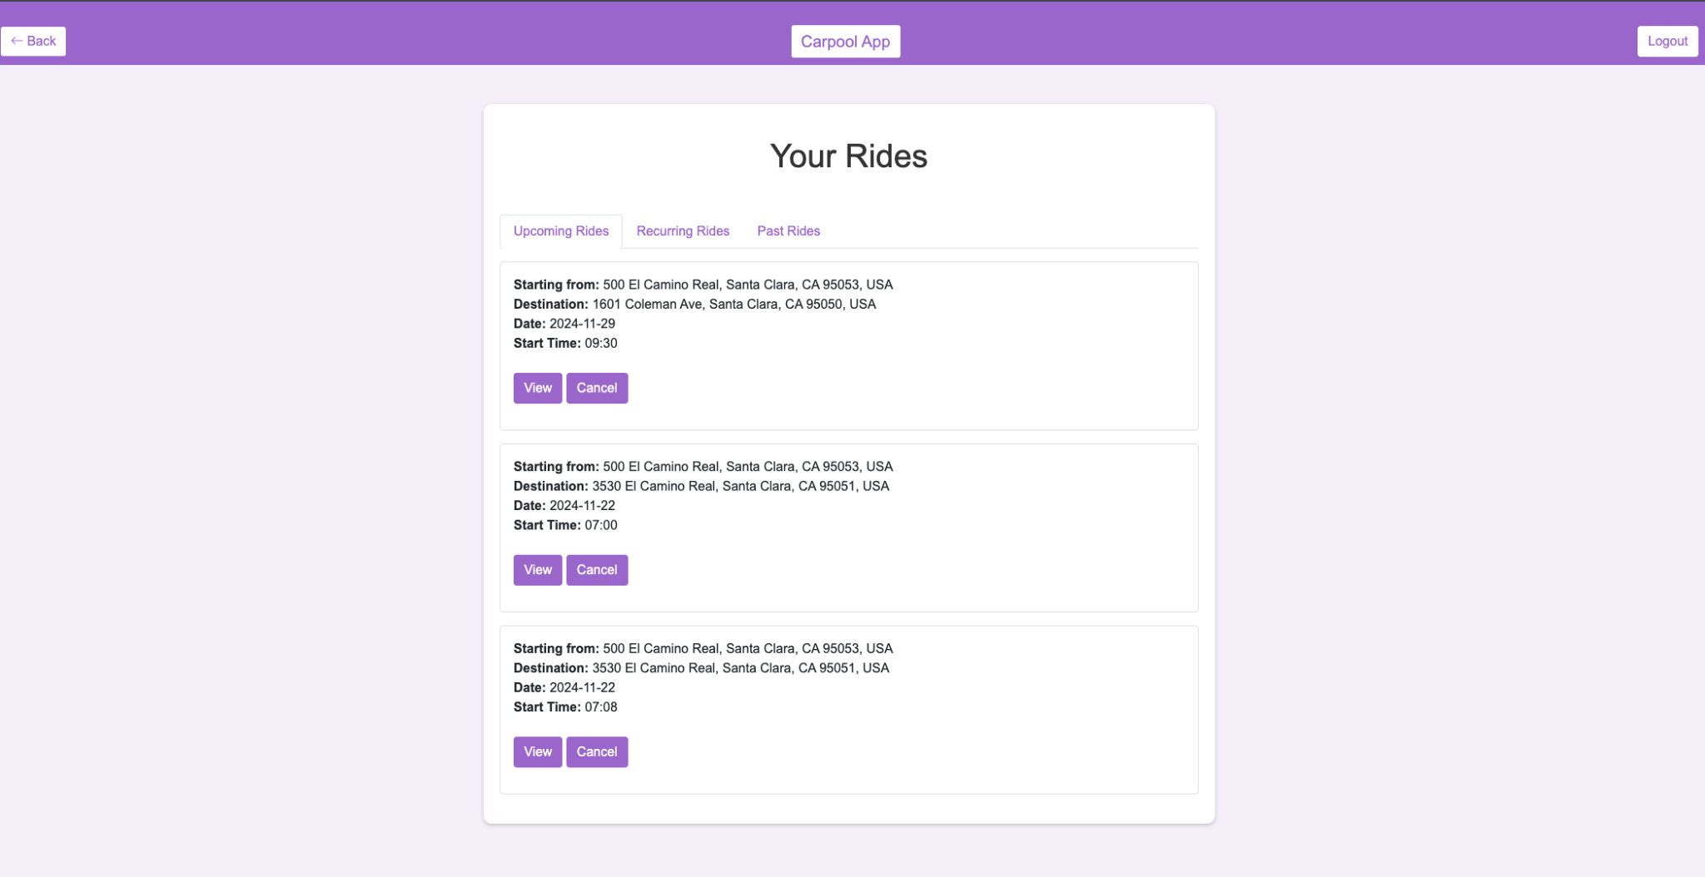
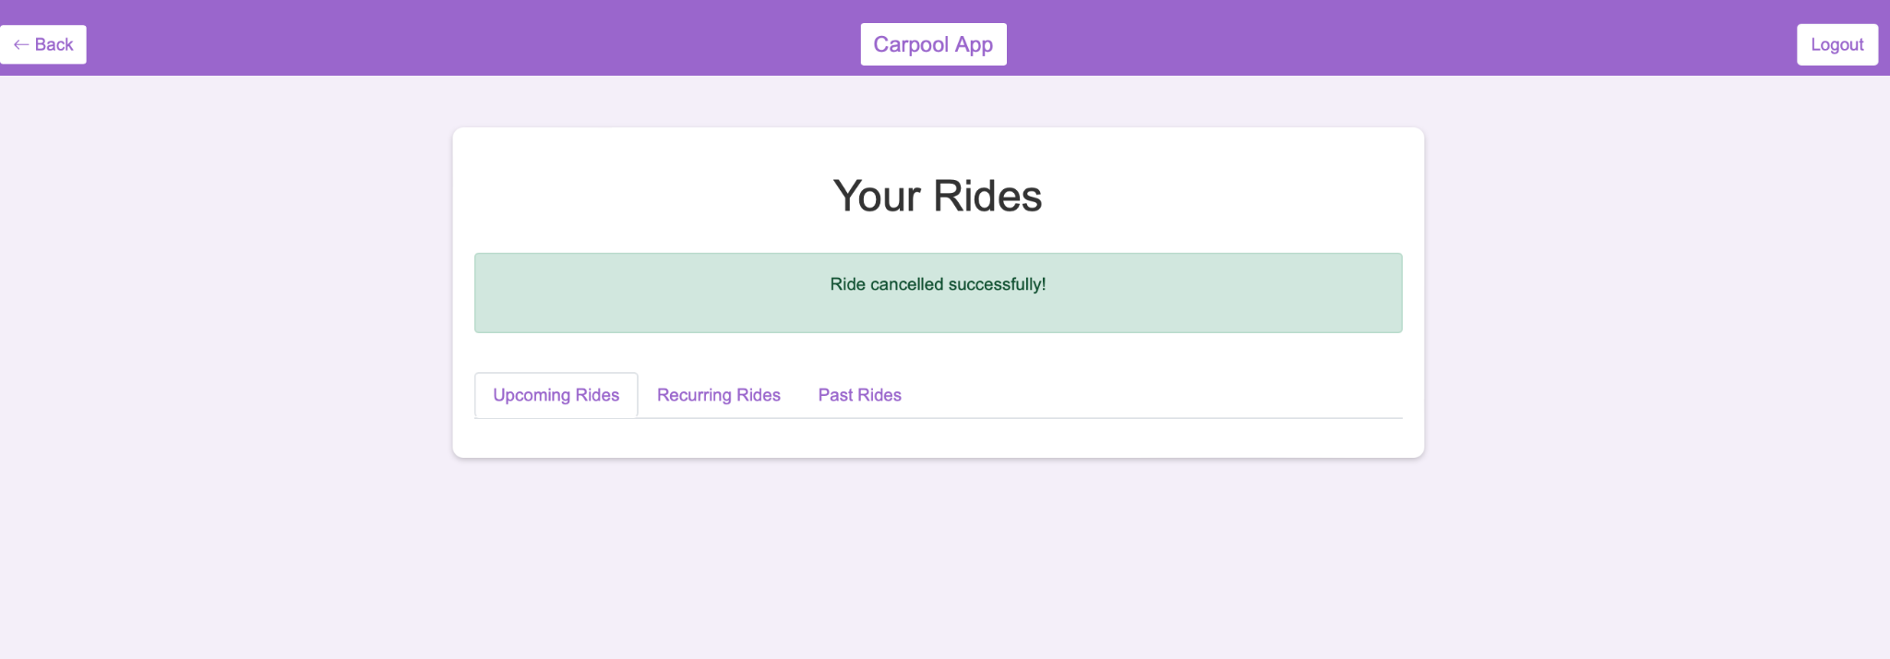
Find Ride

Slide 33
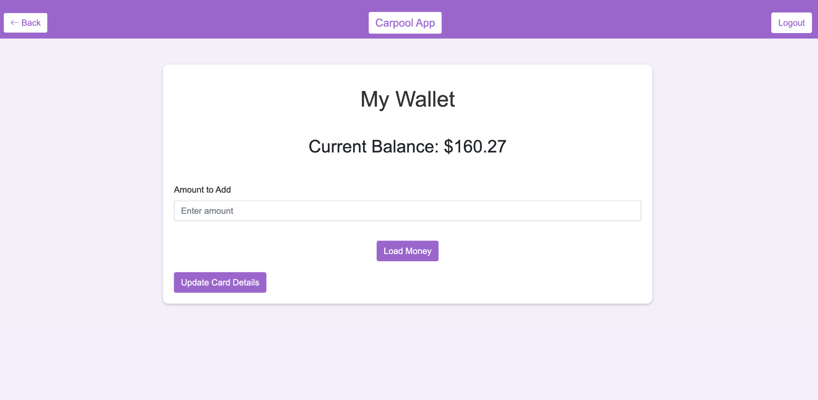
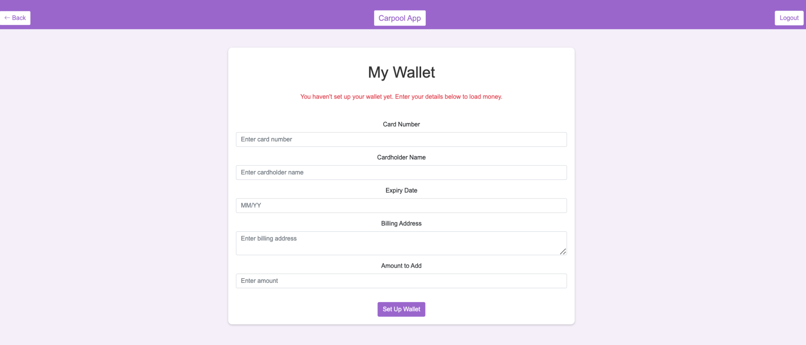
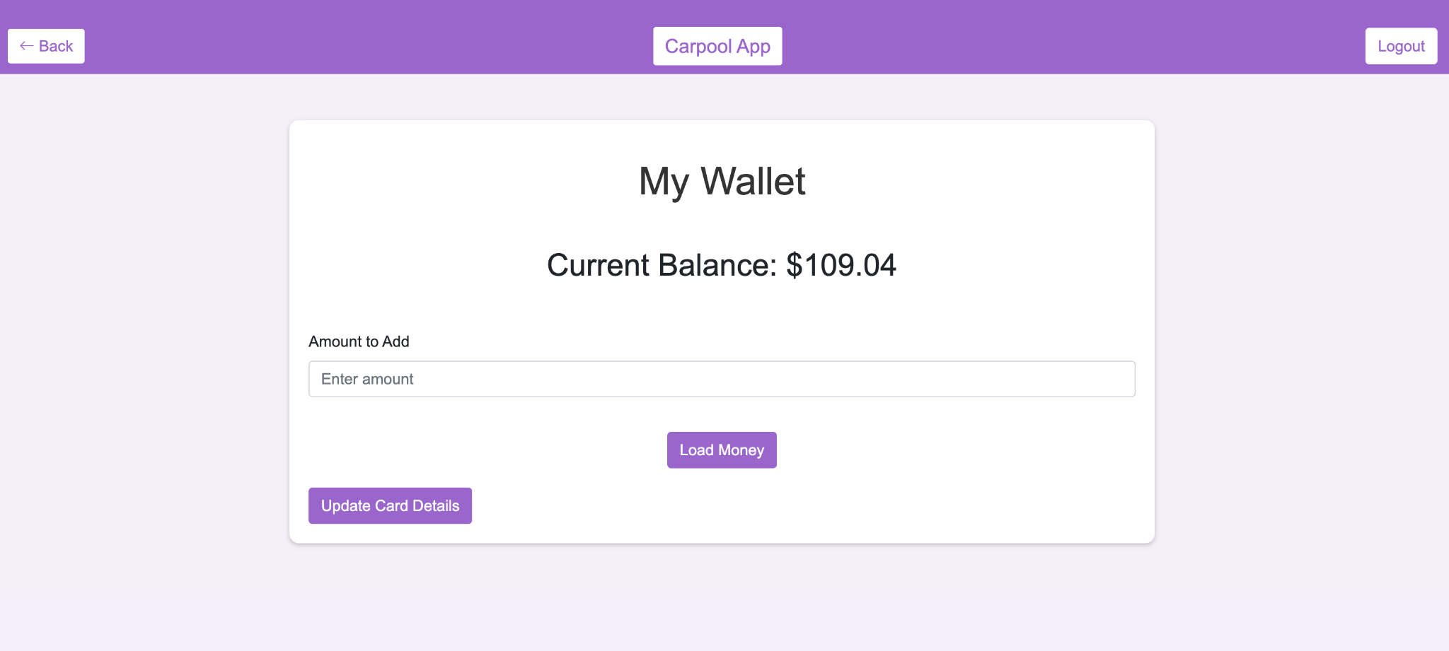
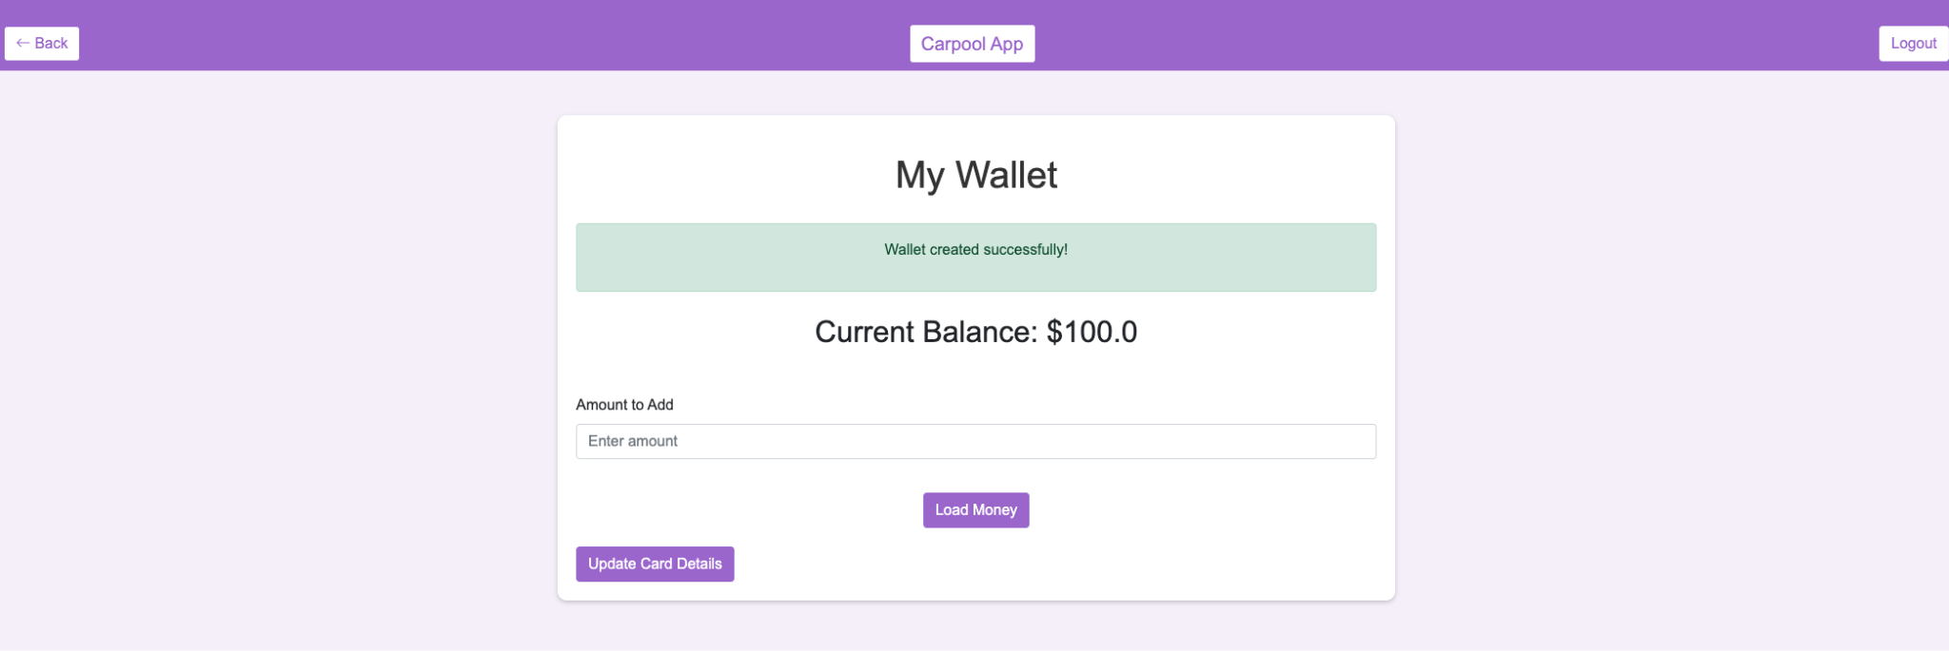
Wallet
d

Slide 34

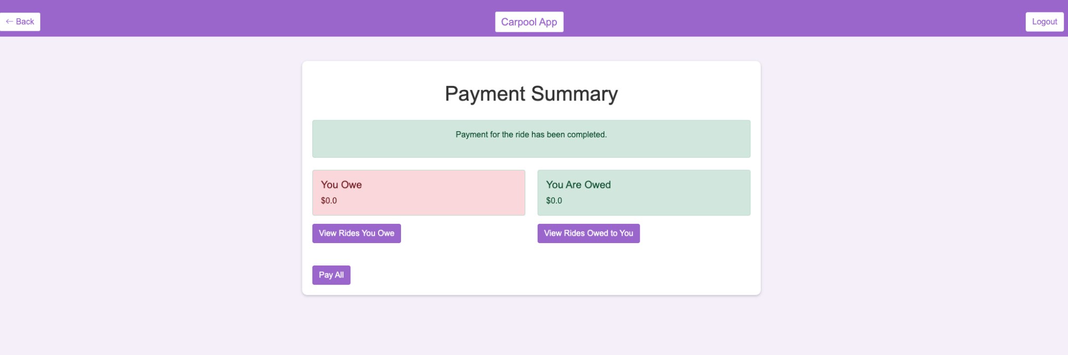
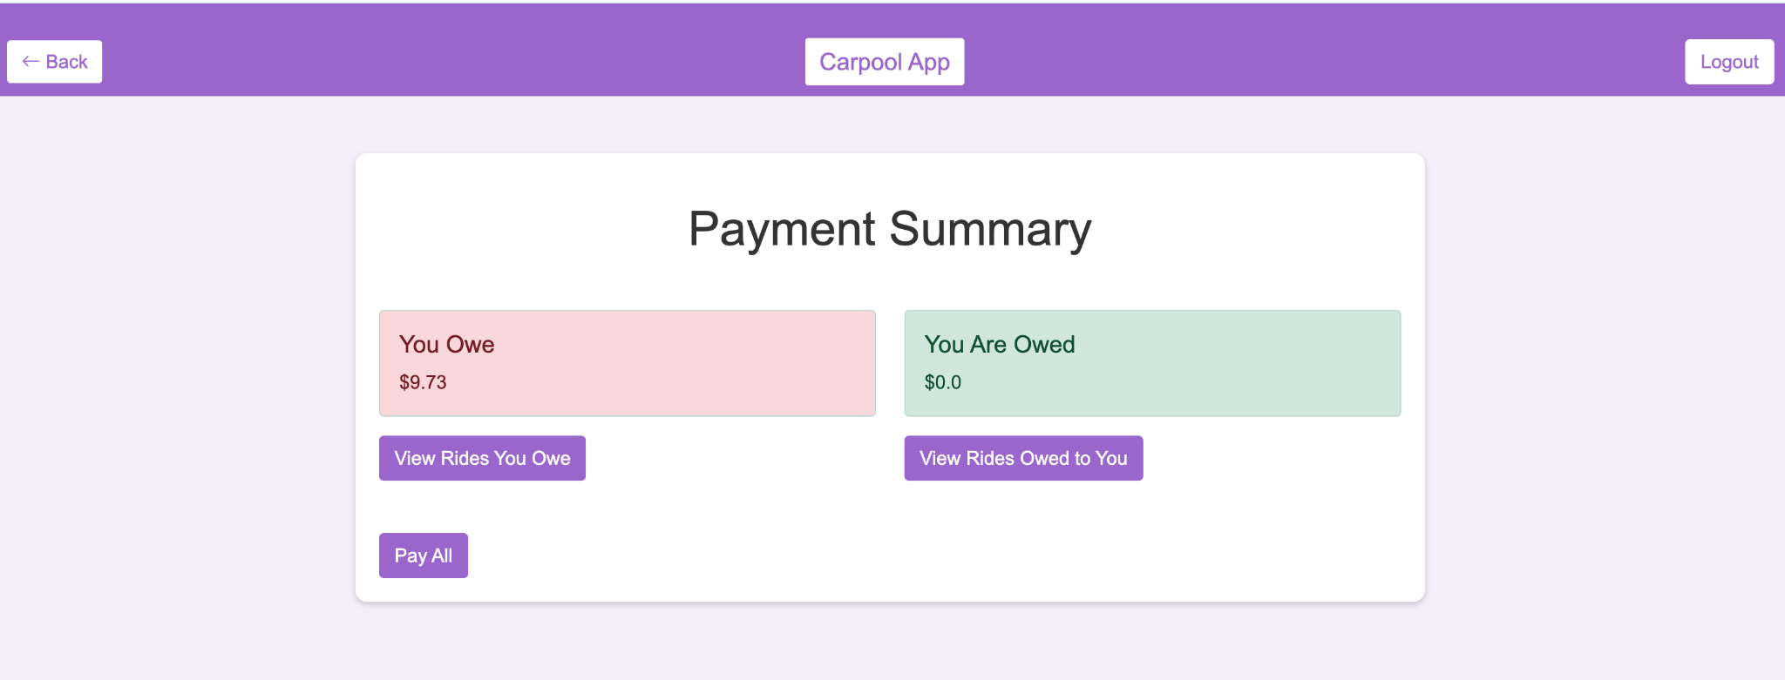
Payments

Slide 35
Future Scope
Future trends for carpooling applications include AI-powered ride matching, dynamic pricing, and route optimization, promoting sustainability with carbon footprint tracking and electric vehicle integration. Autonomous vehicles could enable driverless carpools, while blockchain enhances secure payments and transparency. Integration with public transit and last-mile mobility solutions offers seamless end-to-end travel. Cloud computing ensures scalability, and partnerships with smart cities and urban planning.

Slide 36
Thankyou!!!

